Slide 1
Hop Hacking Hedy
atlas, cutaway and Q

Slide 2
Authors
atlas
Code monkey
Magical debugging wizard
cutaway
Radio-Fu
Supreme dongle overlord
Q
Hardware-Fu
Creator of sexy slides

Slide 3
Agenda
Prelude
Hedy and her Patent
FHSSWTF
Technical explanation
FHSS Usage and Analysis
Case examples
Problems revolving around FHSS
Possible solutions
Project
What we are developing
Hardware: Devices Utilized, Debugging and Wiring Instructions
Developing and Using the Code Base
Practical Applications for decoding hopping patterns

Slide 4
Prelude
Explanation of the Title
What is a HEDY?
Surprisingly not a lot of people understood the title
That’s right, a focus group was held
So I must explain!
Alternative Title
“3 Dudes and a Dongle”
Not sure we would have been accepted

Slide 5

Prelude
This is a Hedy ☺

Slide 6
Prelude
Hedy Lamarr
Inventor
Supremely nerdy
nerd_chick++;
Actress
Less important here
Sidenote: Military used her celebrity to sell War Bonds instead of her brains to join a panel of scientists during the war. ☹

Slide 7
Prelude
Inventor of “secret communication system”
Along with George Antheil
Patent: 2,292,387
Filed: June 10, 1941
Recognized by EFF in 1997 for her achievements
Go EFF

Slide 8
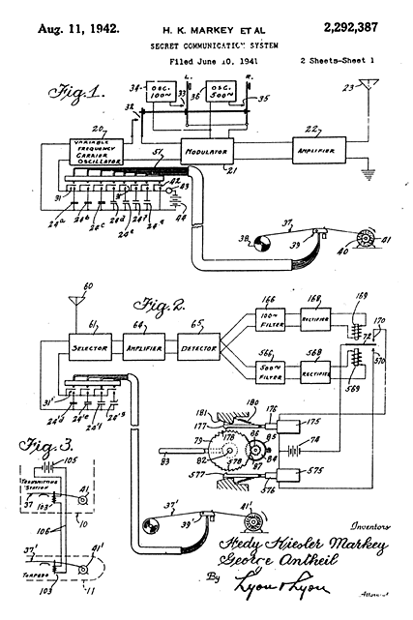
Prelude
Secret communication
TX
VFCO -> Modulator -> Amplifier
RX
Selector -> Amplifier -> Detector
Noise reduction (filtering)
Ya, that’s a piano roll
Used to change between 88 freqs.
Ah, the days before digital
End Result
Impressive for the days of Analog

Slide 9
FHSSWTF
FHSS - Frequency Hopping Spread Spectrum
Transmission method
Carrier is rapidly switched in the frequency domain
Multiple channels
Depends upon bandwidth
Bluetooth – 79 MHz
@ 1MHz channel spacing – 79 channels
Smart Meters – 26MHz
@ 500 kHz channel spacing – 52 channels

Slide 10
FHSSWTF
Pseudo-random sequence to choose frequencies
Known by Transmitter and Receiver
Multiple sync methods
Stored algorithm within memory generates pattern
Creates spread code sequence tables
Possibly stored within a piano roll
If you’re Hedy Lamarr

Slide 11
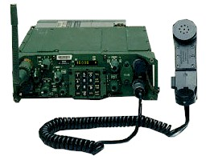
FHSS USAGE
Who uses them?
Military
SINCGARS
Single Channel Ground and Airborne Radio System
Voice-and-Data
25 kHz Channels
30-88 MHz
120-352 channels
100 hops/second
Very slow
Expected to be replaced by an SDR solution
Deployment issues

Slide 12
FHSS ANALYSIS
SINCGARS
Problem: 500,000 units purchased^{[1]} Until the 2008 improvement programs, how many radios were relying on FHSS for security?
How many still are?
Solution: Upgrades provide voice-encryption, though backwards compatible with old radio hardware.
Does security still exist if you’re supporting ancient hardware?
SDR solution provides field-programmable devices
Interesting!
See: JTRS Project
[1] – Reference: http://defensesystems.com/microsites/2010-peo-c3t/not-your-father-radios.aspx

Slide 13

FHSS USAGE
Commercial
Bluetooth
Bandwidth:79 MHz
Channel Spacing: 1 MHz
Total Channels 79
3200 clock cycles
Hops every other
1600 hops/second

Slide 14
FHSS ANALYSIS
Bluetooth
Problem: With commercially available hardware (USRPv2) you can generate hopping patterns for an entire technology within 24 hours and utilize this for future patterns.
Solution: We can’t rely on FHSS as an implementation of a security model within our technology. We must do better.
Encryption! Yes, please.

Slide 15
FHSS Is not ENCRYPTION
“In FHSS, the frequencies to be used in the hopping sequence may be selected by the user. In the unlicensed band, any group of 26 frequencies or more (out of the 79 available) is legal. To “tune in”, a listener should know the number of frequencies selected in the system, the actual frequencies, the hopping sequence, as well as the dwell time! The FHSS modulation acts as a layer 1 encryption process. There could be no need for application level encryption!”
Reference: “FHSS vs DSSS in Broadband Wireless Access and WLAN”
Sorin M. Schwartz

Slide 16
FHSS ANALYSIS
Why do we keep using it?
Helps prevent overuse in unlicensed bands
Especially with adaptive technology
Attack Vectors
Must have the hopping pattern to jam or receive entire data stream
Break the PRNG associated with the algorithm
Obtain spread codes
Analyze channel data in time domain fast enough to catch the hops until repeats start to occur
Generate the entire pattern for all clock values
Reference: Ossmann/Spill Shmoo 2009

Slide 17
Solutions
Learn from our experience
We have seen this issue in the Smart Grid industry
Some 1st generation devices relied on FHSS as primary prevention of eavesdropping
2nd and 3rd generation introduced encryption and signing of keys
Do not rely on a single point of failure

Slide 18
Project
Inspiration
False assumptions that speed and pseudo random sequence creates a secure transmission
Simply untrue with the powerful technology we have available
Let’s build some devices that
Can be configured for known ISM bands
Automatically analyze channel spacing
Can Decode FHSS Hopping Patterns
Utilize a custom code-base with far-reaching capabilities to get people started
That is the goal of our project …

Slide 19
PROJECT
In 1942 Hedy Lamarr and George Antheil helped develop a system to assist in the prevention of jamming American radio-controlled torpedoes.
69 years later, it’s time to upgrade …

Slide 20
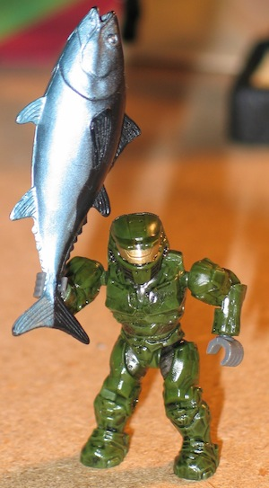
H4RDW4RE
Cutaway’s Initial Interest
Started out as bootstrap for hardware and firmware interaction
Reading is one thing, but you don’t really know anything until you have destroyed something……that belongs to atlas
Get to eat Sushi…at ShmooCon
Get Tuna to buy me more drinks…at ShmooCon

Slide 21
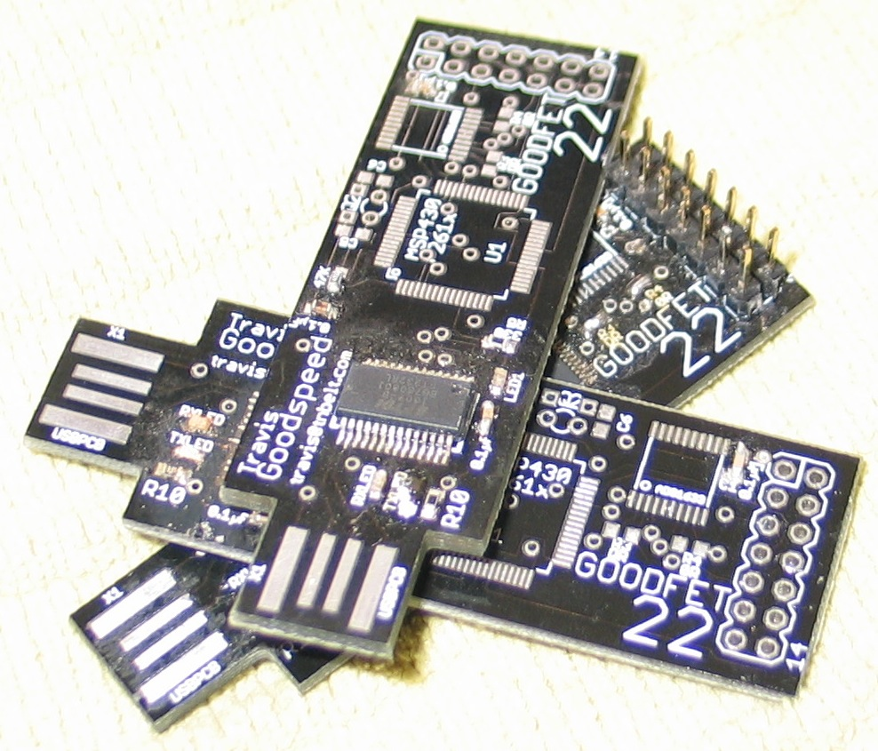
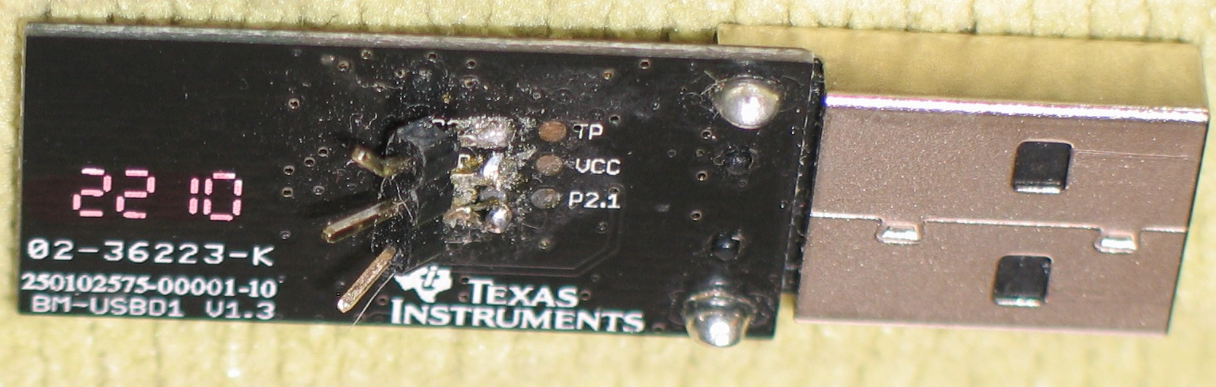
H4RDW4RE
Goodfet Graveyard
eZ430-Chronos Dongle

Slide 22
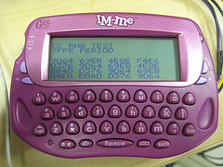
H4RDW4RE
GoodME Project
Cons
Already being worked by atlas, Q, Travis, and Mike
Pink might be pretty but some people just don’t get it
Pros
CC1110-based
Great place to start
Actively being worked

Slide 23
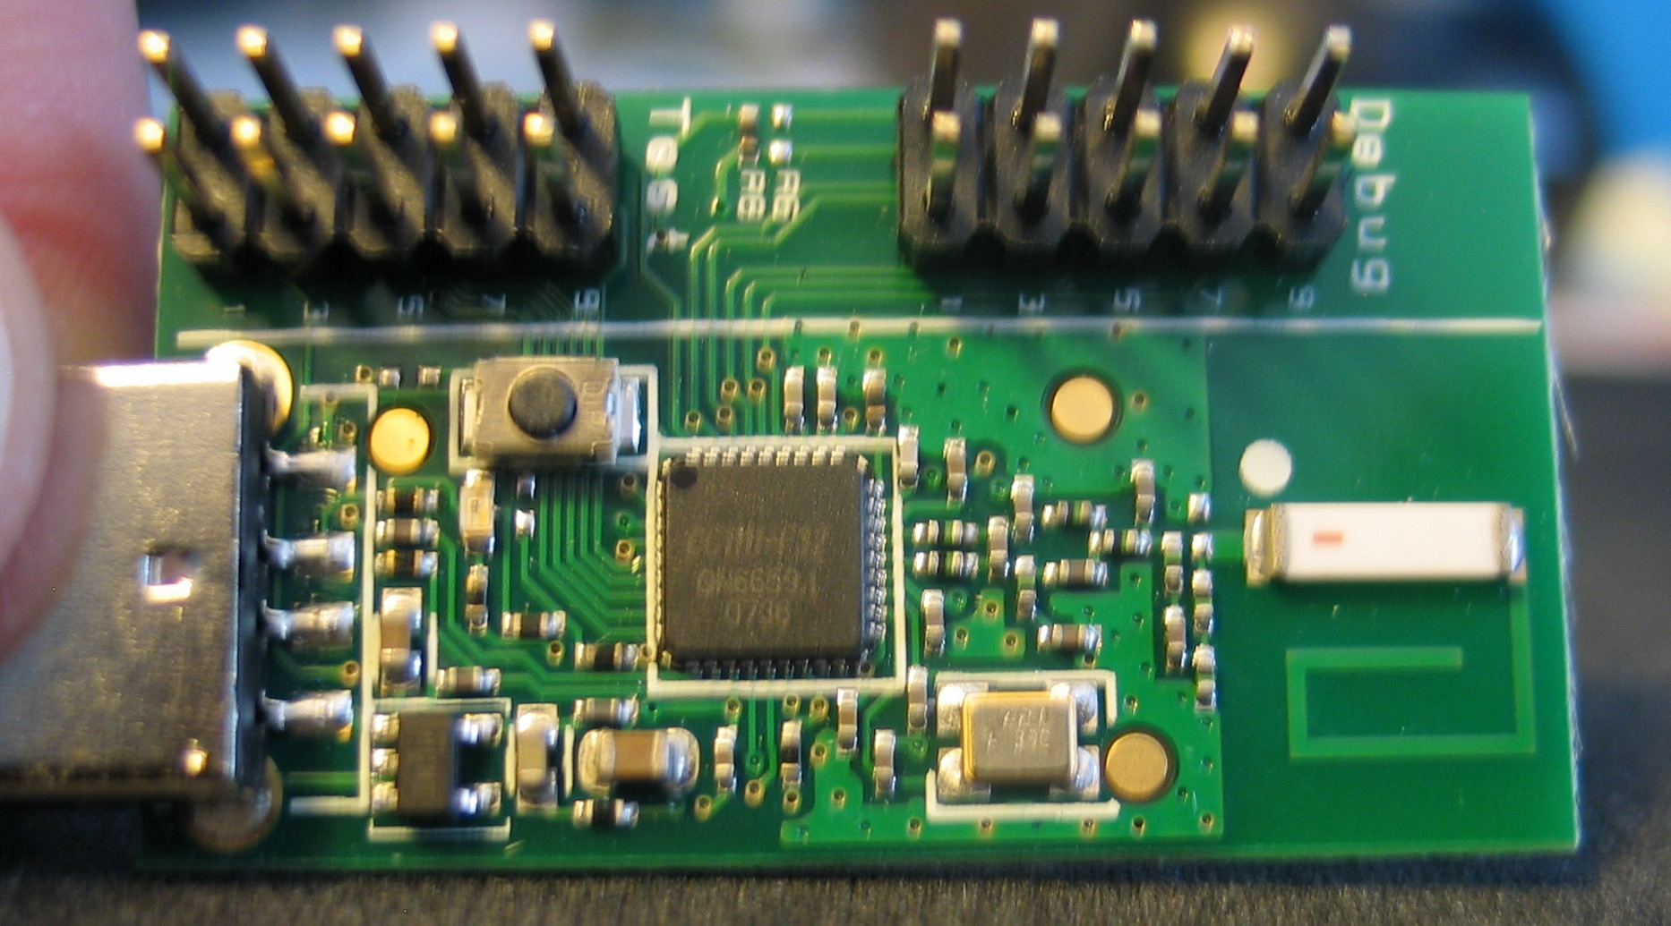
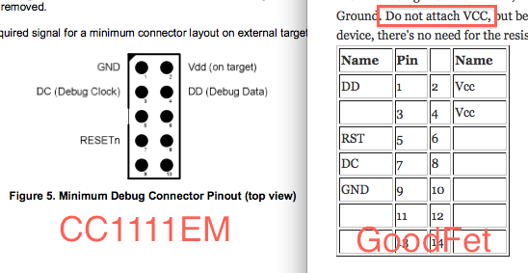
H4RDW4RE
CC1111EMK868-915 Evaluation Module Kit
CC1111-based
All pins broken out
Programmable via Goodfet
Goodfet.cc interacts via Data Debug

Slide 24
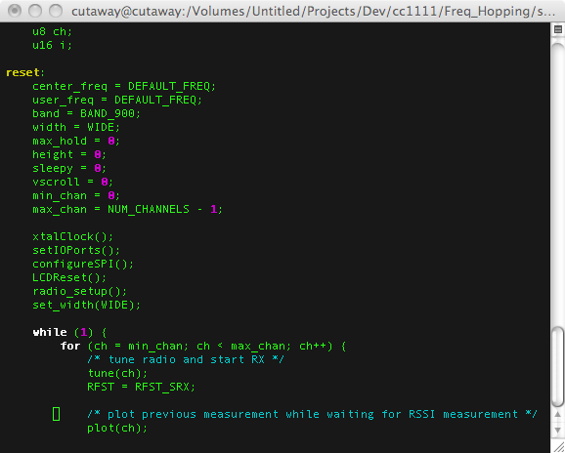

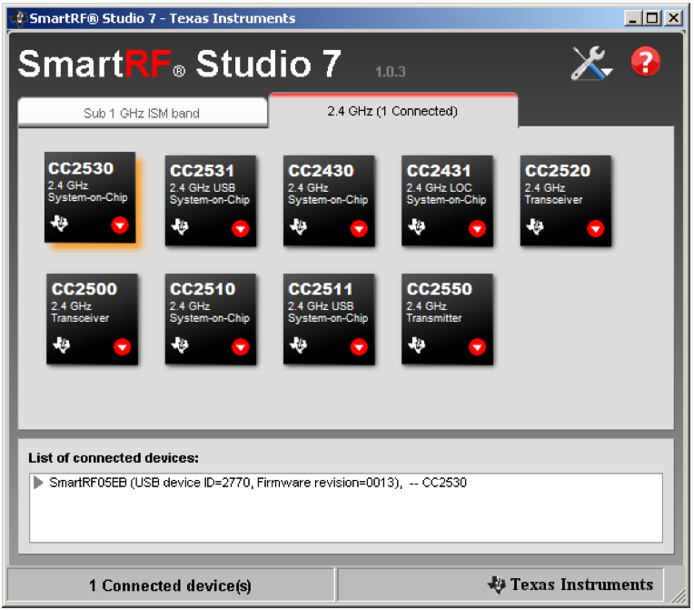
H4RDW4RE
Code Beginnings
Hello World – Blinking LED
Board data from TI’s IAR Demo
Bloated and Complicated
Reference documents for CC111*
SmartRF Studio – provides radio data
Specan code includes everything you need
Watch your clocks and pins

Slide 25
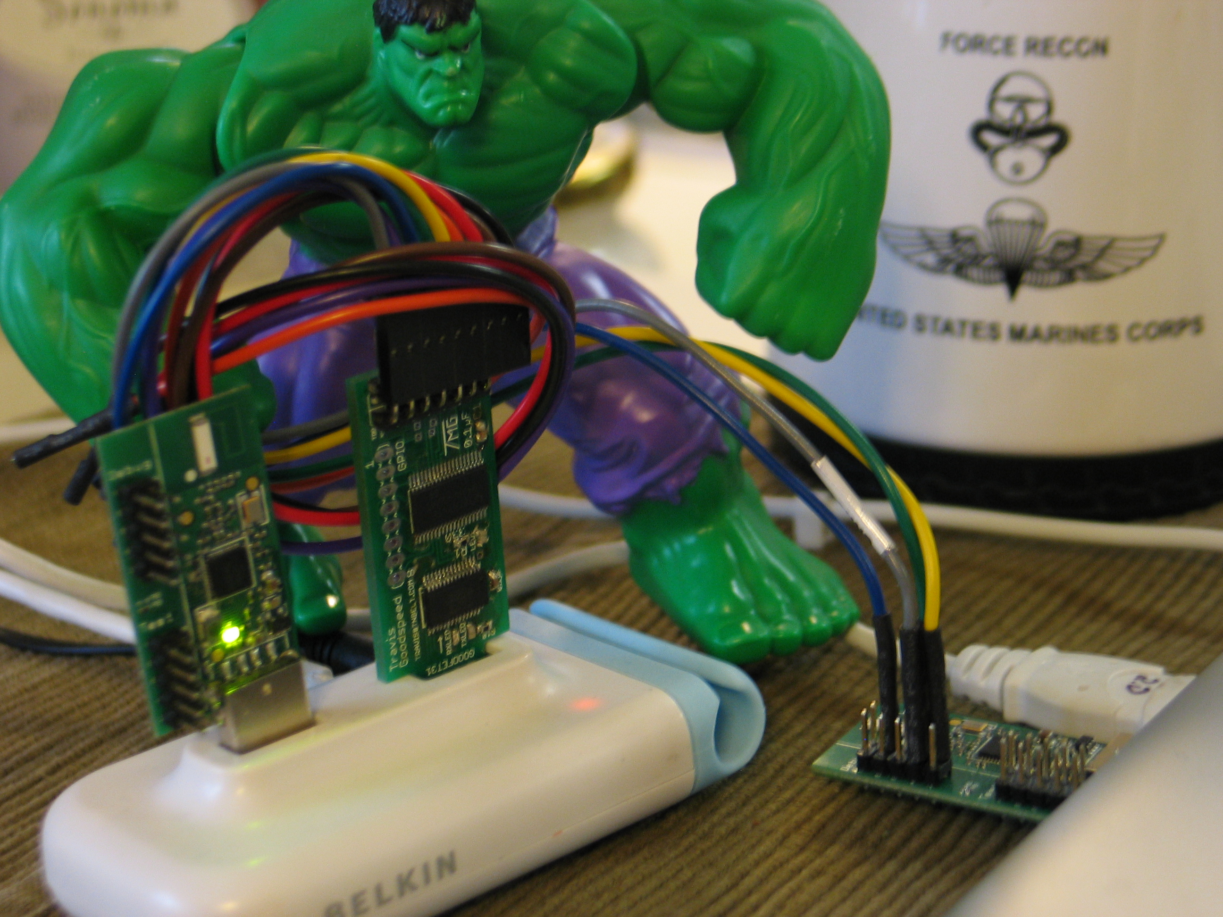
H4RDW4RE
Code Advances
Prerequisites
902 - 928 MHz Range
Fast scanning
Strip Specan Firmware Code
Remove display (but compensate for delay)
Shrink frequency range
Leverage Goodfet
Data Debug dumping
Python scripts for displaying data
Halting CPU – affects results

Slide 26
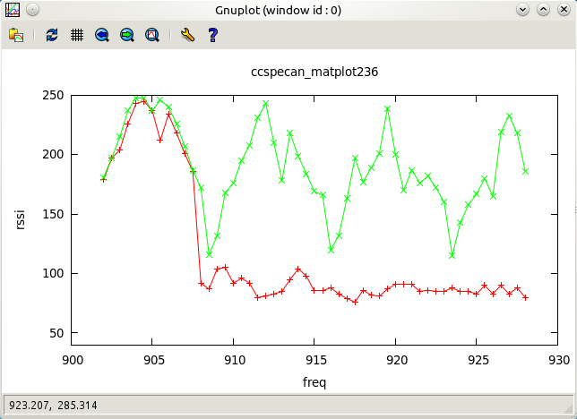
H4RDW4RE
Resulting Firmware
maxscan – spectrum analyzer
hoptrans – create a carrier wave
Number of channels is known
Channel spacing is known
Hop timing is known

Slide 27
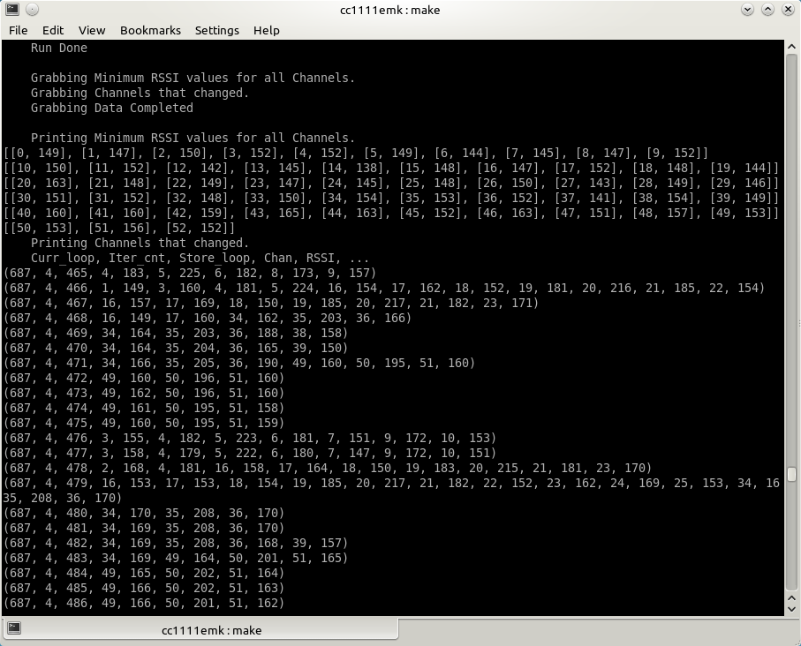
H4RDW4RE
Resulting Firmware (2)
Minscan – detects channel hops
Initializes frequencies
Scans frequencies for minimum RSSI
Monitors jumps in RSSI
Stores detected spikes
Data dump via Goodfet
Data is analyzed offline

Slide 28
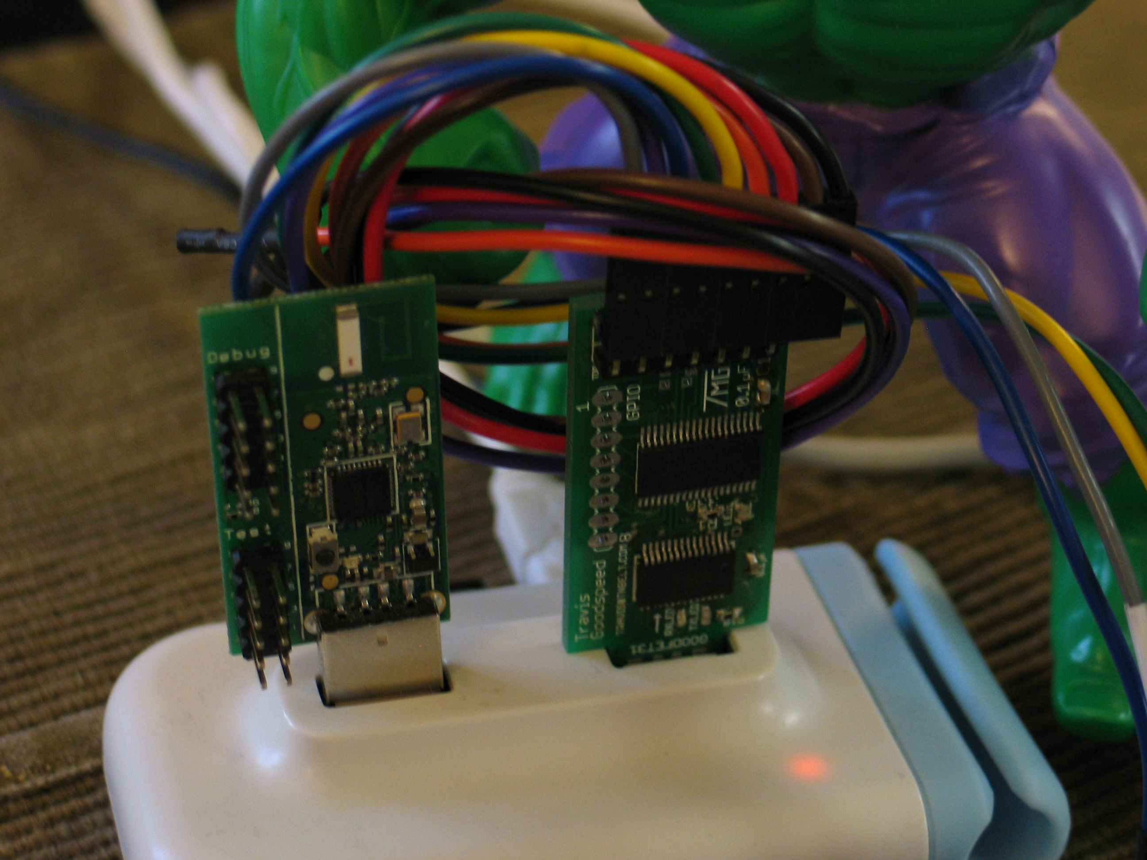
H4RDW4RE
Issues
Data Debug dump via Goodfet is slow
Pausing CPU creates gaps in monitoring
Memory on CC1111EMK is too small
UART would work, but USB would be better
CC1111EMK can do USB but must be managed via firmware

Slide 29
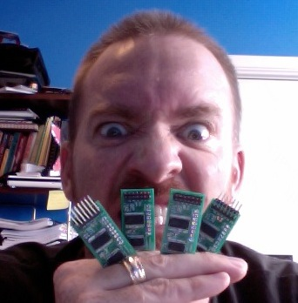
H4RDW4RE
Lessons Learned
Hardware is HARD
When you start
You WILL fail, drive on
Hardware documentation is CONFUSING
You get better with time
The documentation DOES NOT
Radios are complex
Hardware radios ARE complicated
SmartRF HELPS
IM-ME code is an EXCELLENT example
We CAN see good results in test data
This IS step in a right direction

Slide 30
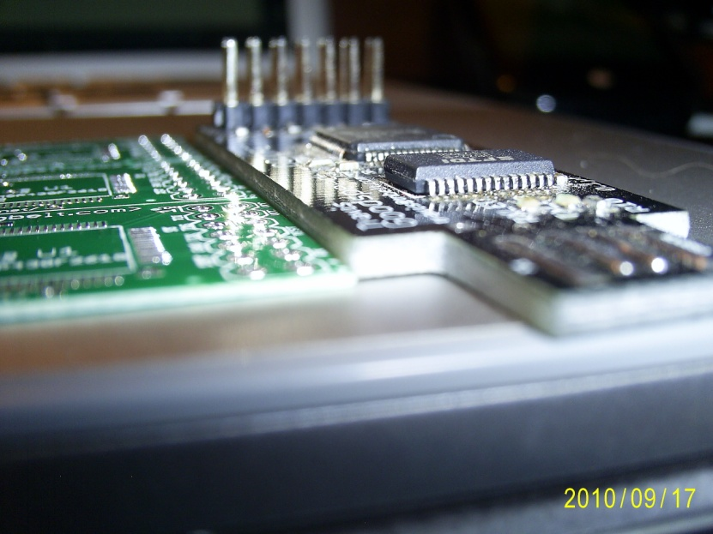
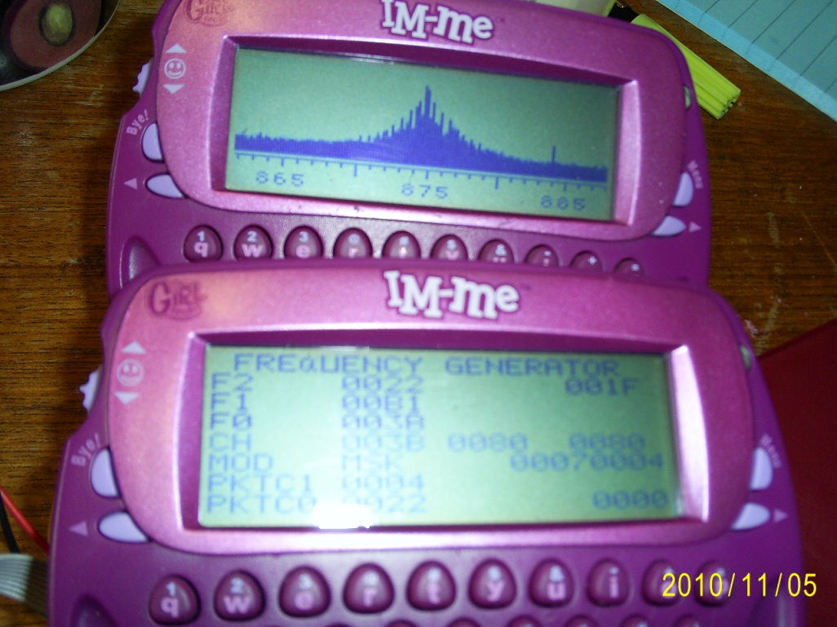
C0DE
Overview
CC1111
Merging Code
Screen Shots of Code Running
GNU Plot
Stages of Analysis
Goals of Code
Where we are Currently

Slide 31
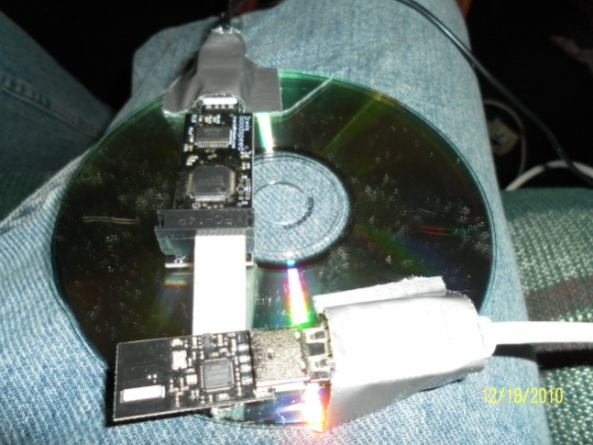
CC1111
USB-enabled version of TI’s most popular <1GHz radio/mcu
Same radio used in the majority of today’s Smart Meters
“easy” usb! Yeah right. YOU MUST READ “USB IN A NUTSHELL”
Separate cc1111usb project soon to be released
GPL
Hacker-written (good or bad?)
Contained in one .c and one .h

Slide 32
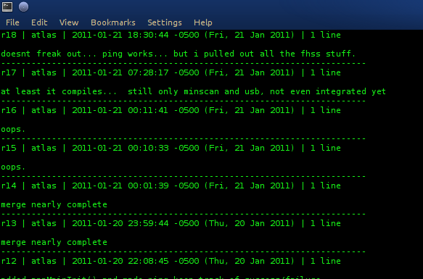
Merging Code
“Messing up code”
Still buggy, although somewhat less thrashing
USB code was *really* a mess when we started

Slide 33
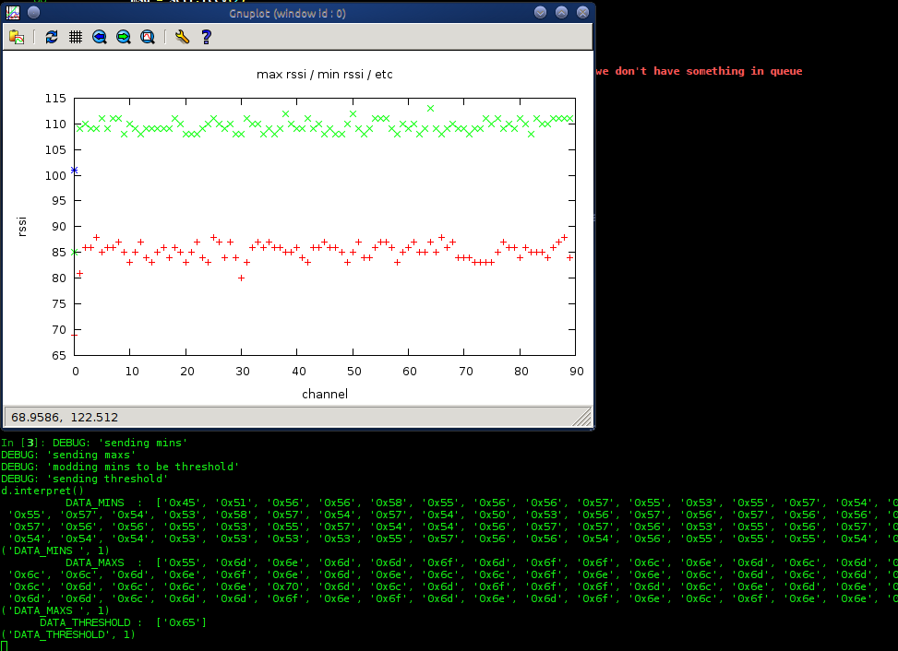
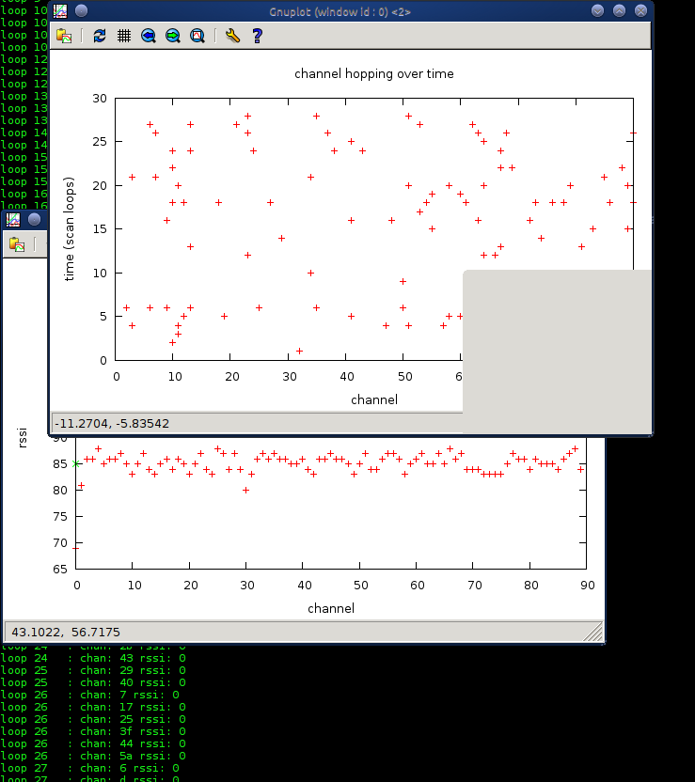
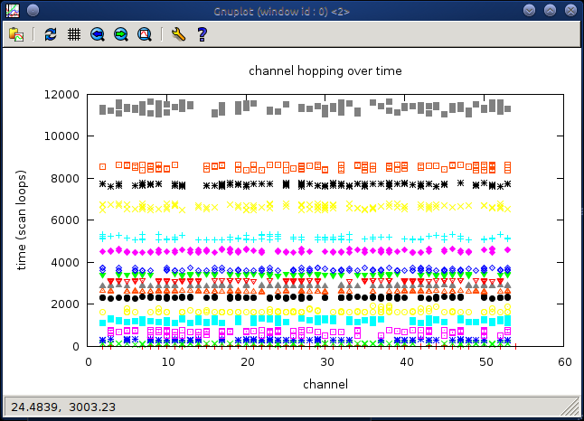
Screen shots of code running

Slide 34
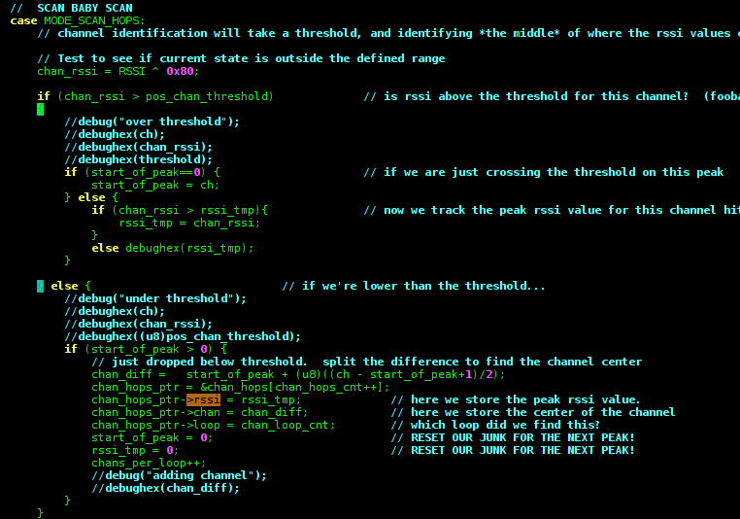
Intro to code
Python Client using libusb (requires admin access)
d.dump*() – grab large chunks of data from dongle
d.get*() – grab incidental settings
d.set*() – set incidental settings (threshold, channel info)
d.doFloorAndCeiling()
d.doChannelIdent()
d.doHopTracking()
d.interpret() – spits out formatted data, and plots
GNUplot - Really fun way to wow people who don’t get gushy over green on black…

Slide 35
Steps of analysis
Floor and Ceiling – mins and maxes
Channel threshold – how do we know when we’ve found a channel?
Channel Identification and Spacing – currently broke
Hopping pattern – this is the shizzle
Predictive Analysis (future)
Sync Word – radios know when data is coming (future, easy)
Data Rate – duh, like a modem (future, limited possibilities, often documented)

Slide 36
Goals of code
Dispell myths of FHSS security (obviously)
Weaponization and Automation
Network Sniffing
Network Participation
Reduce time for real security testing

Slide 37

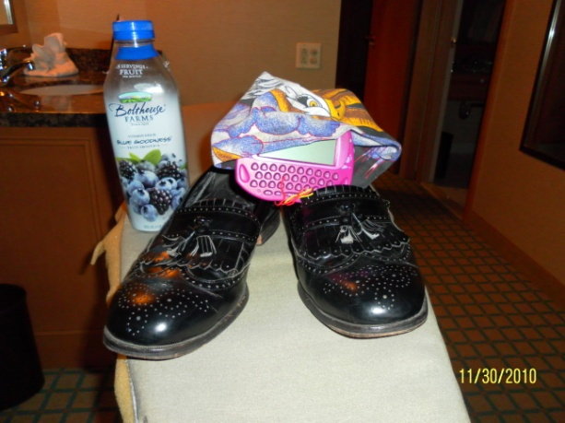

Where we’re at
USB-controlled radio – great platform to play
Calibration and Speed
Channel identification – broken but close
Hopping identification – some bugs in data storage and dumping
GNUplotting for hollywood enjoyment (hey hollywood)
Still need to analyze and coalesce final data better
Want to port it to the CC1110 of the IM-ME Dongle

Slide 38
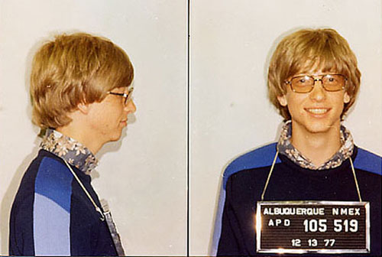
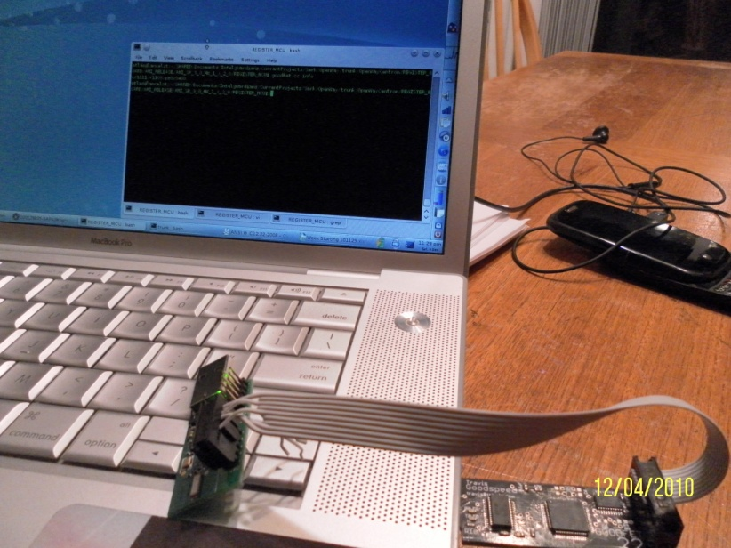
Acknowledgements
Travis Goodspeed
Not only is he a master of the belt buckle but a supreme commander of all things Good and FET
Check out the GoodFET project
http://goodfet.sourceforge.net/
“Michael Ossmann Is My Hero”
He has T-Shirts that say so …
Creator of neighborly spectrum analysis software
Developed at the last SHMOOCON!
http://www.ossmann.com/
Bill Gates
Brett and Jemain, and Bagettes

Slide 39
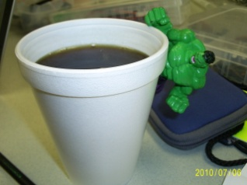
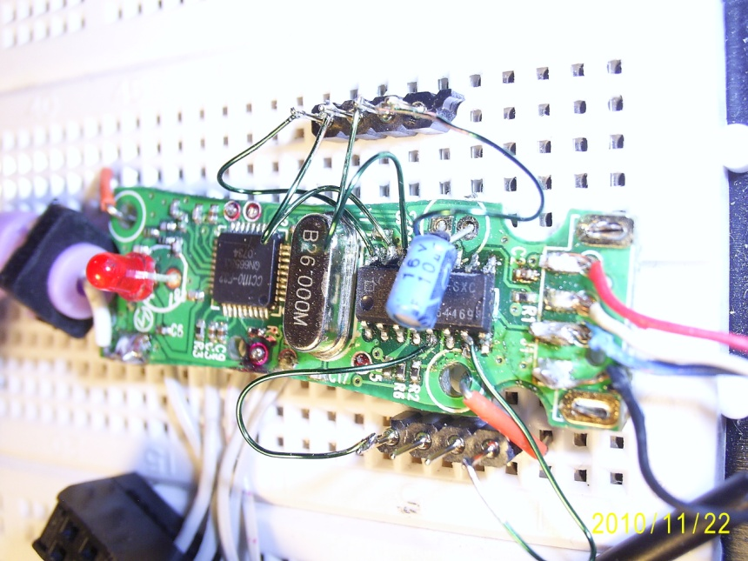


Project Information
Google Code Page
http://code.google.com/p/hedyattack/
Member Information
atlas
atlas@r4780y.com
Don C. Weber
don@inguardians.com
Andrew Righter
andrew@inguardians.com

Slide 40
Questions & Answers
if time_remaining != 0:
answer_questions( );
else:
print(“sorry!”);

